Slide 1
The Harlem Renaissance
Lydia Mathis

Slide 2
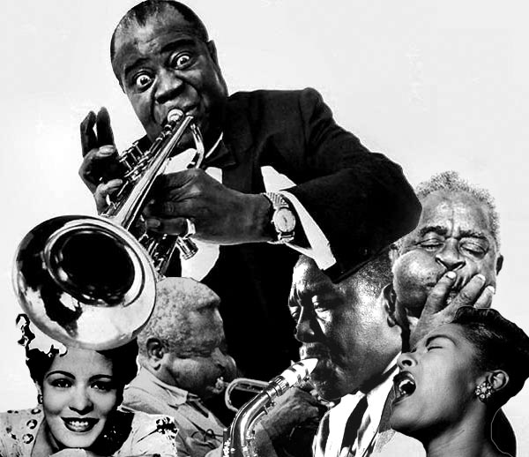
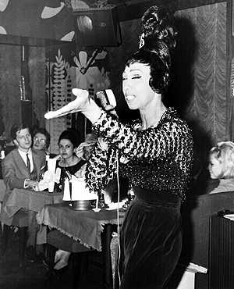
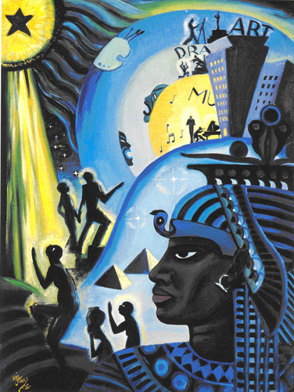
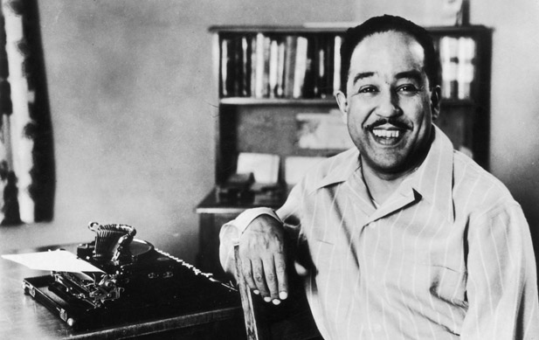
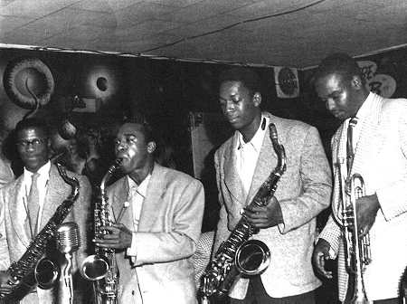
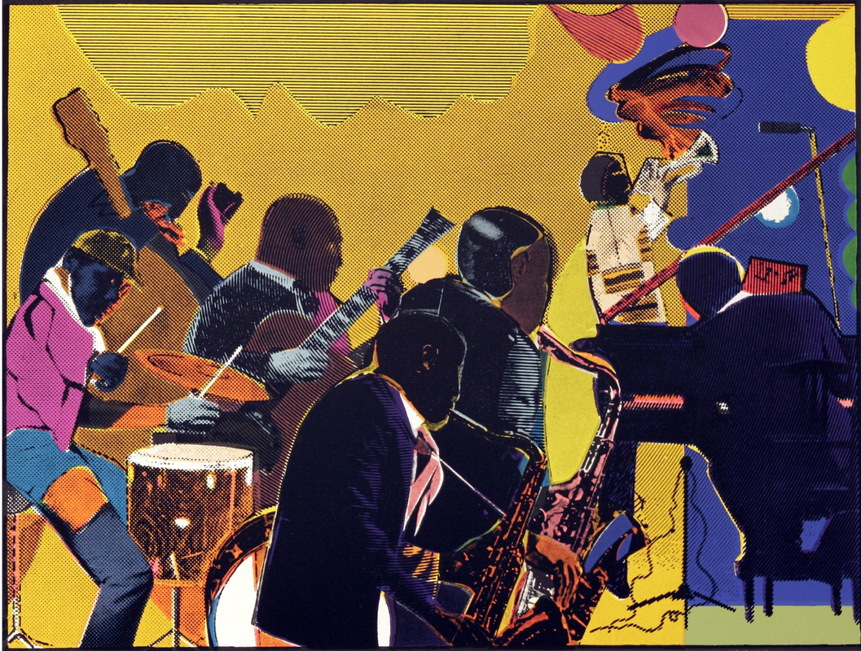
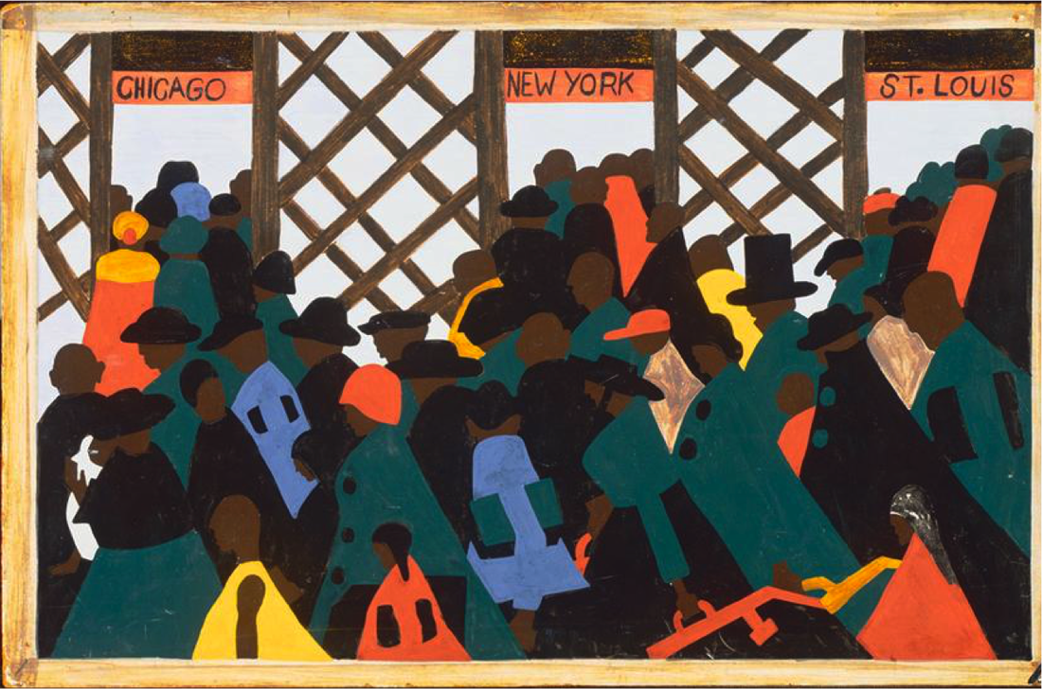
The Harlem Renaissance
Figure 1-7 (clockwise)

Slide 3
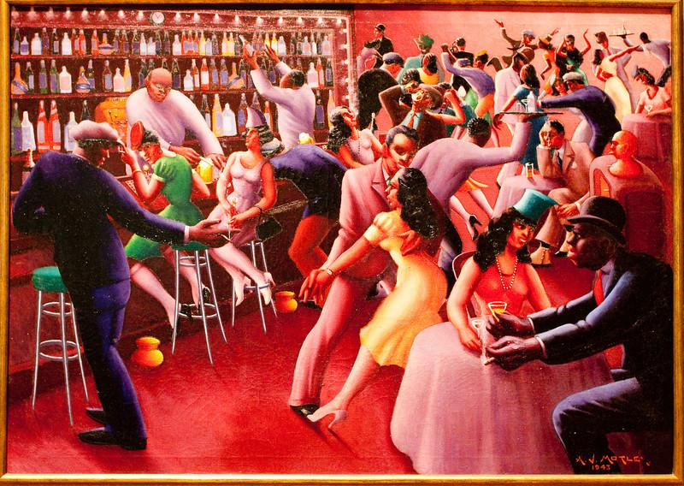
A brief on the Harlem Renaissance
The Harlem Renaissance was an opportunity for African Americans to express themselves through music, art, literature, and intellect.
Figure 8.
Notes:
Explains what HR is.

Slide 4
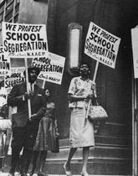
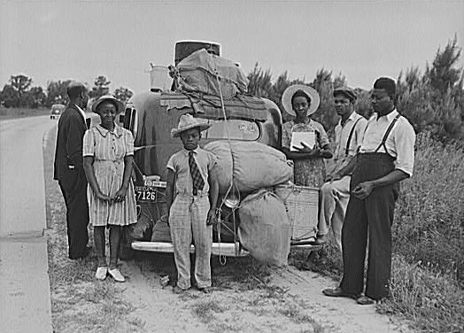
The Great Migration
Figure 9.
Figure 10.

Slide 5
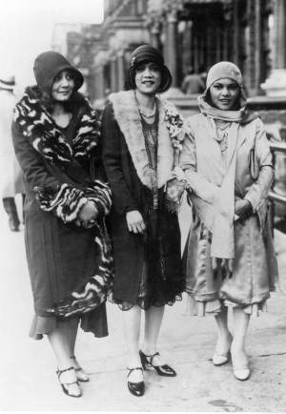
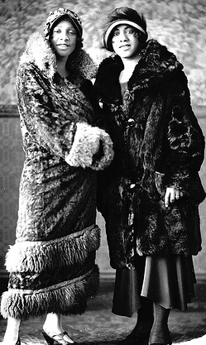
The New Negro Image
Figure 11.
Figure 12.
Notes:
Explains how Black People wanted to be viewed back then.

Slide 6
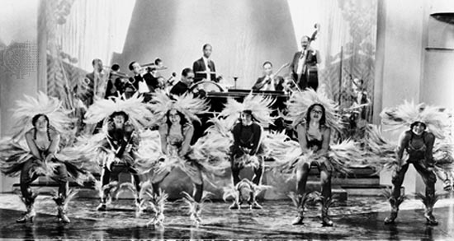
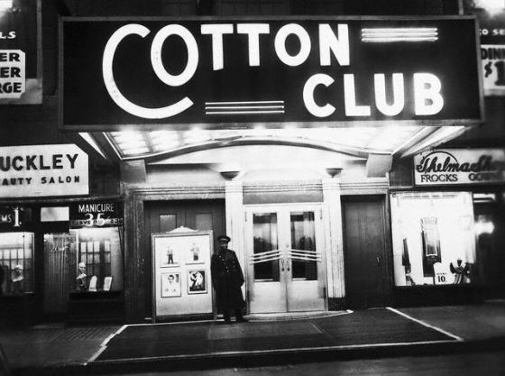
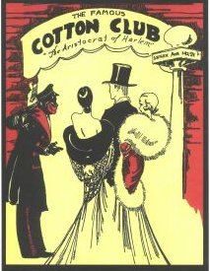
The Cotton Club
Above: Figure 14.
Left: Figure 15.
Figure 13.

Slide 7
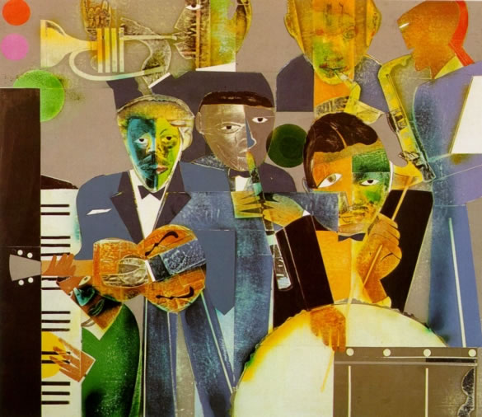
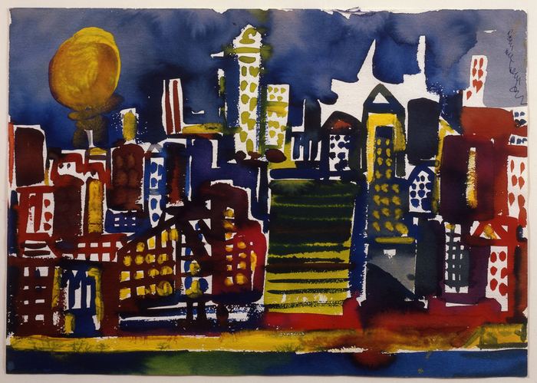
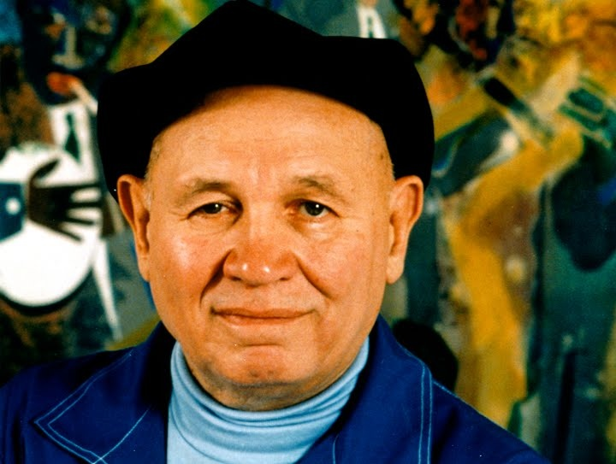
Romare Bearden
Fig. 244
Figure 23.
Figure 25.

Slide 8
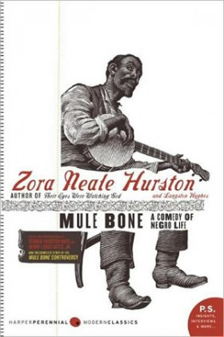
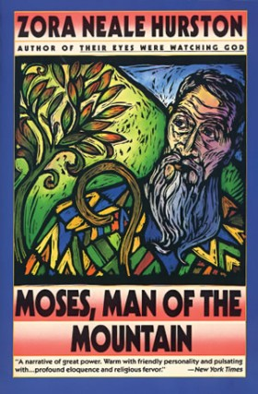
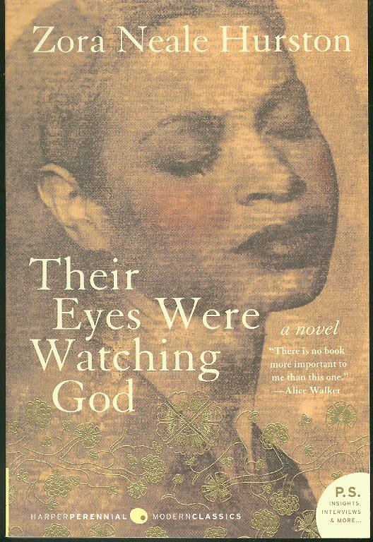
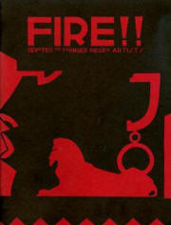
Literature
Figure 28.
Figure 26.
Figure 29.
Figure 27.

Slide 9
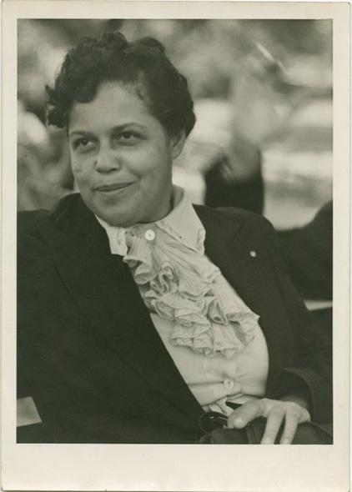
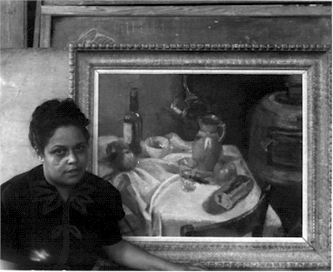
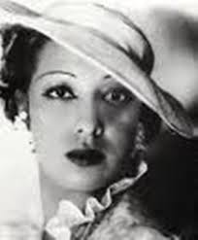
Gwendolyn Bennett
Figure 17.
Figure 16.
Figure 18.

Slide 10
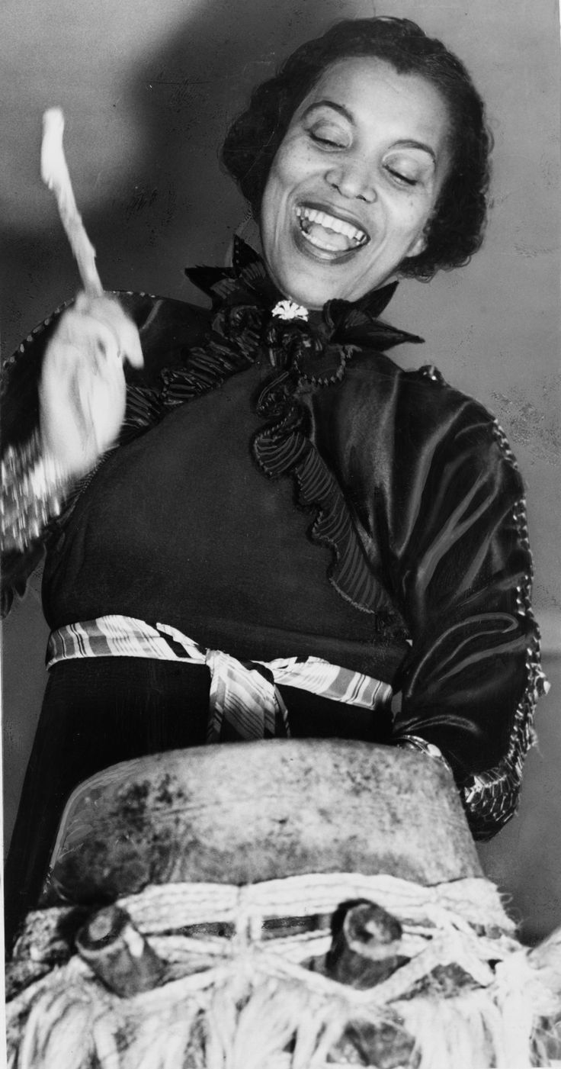
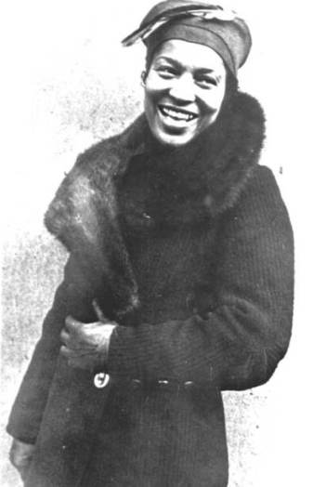
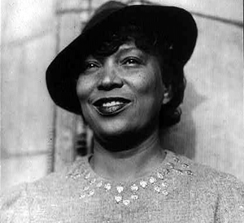
Zora Neale Hurston
Figure 19.
Figure 20.
Figure 21.

Slide 11
Works Cited
Boyd, Valerie. "About Zora Neale Hurston." The Official Website of Zora Neale Hurston. Sonnet
Media, 2013. Web. Mar. 2014.
"Cotton Club." Encyclopaedia Britannica. Britannica Academic. Encyclopædia Britannica Inc., 2016. Web.
18 Apr. 2016.
"Gwendolyn Bennett." Encyclopaedia Britannica. Britannica Academic. Encyclopædia
Britannica Inc., 2016. Web. 18 Apr. 2016.
"Romare Bearden." Encyclopaedia Britannica. Britannica Academic. Encyclopædia Britannica Inc., 2016. Web. 18 Apr. 2016.
Sonneborn, Liz. The Great Black Migrations : From The Rural South To The Urban
North. New York: Chelsea House, 2010. eBook Collection (EBSCOhost). Web.
18 Apr. 2016.

Slide 12
Works Cited (Figures)
(Figure 1.)
Bowler, Rams. “Harlem Renaissance”. Deviantart. 27 February 2007. Web. 24 March 2014 <http://ramsbowler16.deviantart.com/art/Harlem-Renaissance-49781855>
(Figure 2.)
Jaztine. “How Segregation Influenced The Harlem Renaissance”. The Harlem Renaissance. 6 February 2013. Web. 24 March 2014 <http://jaztine.edublogs.org/2013/02/06/how-segregation-influenced-the-harlem-renaissance/>
(Figure 3, 5, 6)
Dewilde, Jordan. “Arts of the Harlem Renaissance”. Wilde Art. 6 February 2013. Web. 24 March 2014. <http://www.jordandewilde.com/2/post/2013/02/arts-of-the-harlem-renaissance.html>

Slide 13
Works Cited cont.
(Figure 4.)
“Harlem Renaissance Figures”. Famous Harlem Renaissance People. 2013. Web. 24 March 2014. <http://www.biography.com/people/groups/movement/harlem-renaissance/photos/harlem-renaissance-figures>
(Figure 7.)
Pepin, Elizabeth. “Harlem of the West: The San Francisco Fillmore Jazz Era author Elizabeth Pepin”. Jerry Jazz Musician. 16 August 2006. Web. 24 March 2014
<http://www.jerryjazzmusician.com/2006/08/harlem-of-the-west-the-san-francisco-fillmore-jazz-era-author-elizabeth-pepin/>

Slide 14
Works Cited cont.
(Figure 8.)
“Artists During the Harlem Renaissance”. Edublogs. 2014. Web. 20 March 2014 <http://group5art.edublogs.org/files/2010/03/motley1.jpg>
(Figure 10.)
“Capturing History”. The Kennedy Center Arts Edge. 2014. Web. 23 March 2014 <http://artsedge.kennedy-center.org/educators/lessons/grade-6-8/Capturing_History.aspx>

Slide 15
Works Cited cont.
(Figure 11, 12, 14, and 15.)
“Harlem Renaissance: History”. Women Of The Harlem Renaissance. Web. 22 March 2014 <http://aawomeninhr.blogspot.com/>
(Figure 13.)
GB, Myra. “Nonfiction Monday: Skit-Scat Raggedy Cat Ella Fitzgerald”. Gathering Books. 26 March 2012. Web. 23 March 2014. <http://gatheringbooks.wordpress.com/2012/03/26/nonfiction-monday-skit-scat-raggedy-cat-ella-fitzgerald/>

Slide 16
Works Cited cont.
(Figure 16.)
“Gwendolyn Bennett, Art Center Director”. New Deal Network. Web. 22 March 2014 <http://newdeal.feri.org/library/k87.htm>
(Figure 17.)
Bennett, Erica. “Gwendolyn Bennett: An Activist of the Arts”. HR Poets. 19 March 2012. Web. 22 March 2014 <http://hrpoets1.wikispaces.com/page/history/Gwendolyn+Bennett+11>

Slide 17
Works Cited cont.
(Figure 18.)
Graham, Maryemma. “The New Negro Renaissance”. Africana Age. 2011. Web. 22 March 2014 <http://exhibitions.nypl.org/arficanaage/essay-renaissance.html>
(Figure 19)
Martin, Renee. “Zora Neale Hurston Biography” Womanist Musings. 7 January 2011. Web. 22 March 2014
<http://www.womanist-musings.com/2011/01/zora-neale-hurston-biography.html>

Slide 18
Works Cited cont.
(Figure 20.)
McClure, Brian. “Zora Neale Hurston: The Howard University Years” State of HBCUs. 20 July 2011. Web. 22 March 2014 <http://stateofhbcus.wordpress.com/2011/07/20/zora-neale-hurston-the-howard-university-years/>
(Figure 21.)
“Gallery | Zora Neale Hurston: ‘The Genius of the South’”. Miami Herald Entertainment. 2014. 22 March 2014. <http://www.miamiherald.com/2008/04/03/481973/gallery>

Slide 19
Works Cited cont.
(Figure 22.)
Lowe, Barbara. “Things I really really love!”. Dangerous Liason. 16 September 2012. Web. 23 March 2014. <http://dangerousliasonsblog.blogspot.com/2012/09/things-i-really-really-love.html>
(Figure 23. and 24.)
“Romare Bearden Art in Harlem Renaissance”. Laniro. 22 December 2011. Web. 23 March 2014. <http://www.laniro.co.uk/x/2a7cf51f62>

Slide 20
Works Cited cont.
(Figure 25.)
Ganzevort, Thomas. “Influences: Romare Bearden”. ineedartandcoffee. 25 June 2010. Web. 23 March 2014. <http://ineedartandcoffee.blogspot.com/2010/06/influences-romare-bearden.html>
(Figure 26.)
Christopher. “Their Eyes Were Watching God”. Fifty Books Project. 14 March 2012. Web. 24 March 2014. <http://fiftybooksproject.blogspot.com/2012/03/their-eyes-were-watching-god-by-zora.html>

Slide 21
Works Cited cont.
(Figure 27 and 29.)
“Books and Audio”. Zora Neale Hurston. 2014. Web. 24 March 2014. <http://zoranealehurston.com/books/>
(Figure 28.)
“Wallace Henry Thurman”. aalbc.com. 2014. Web. 24 March 2014. <http://aalbc.com/authors/wallace.htm>

